Slide 1
PHOTO EDITING - Development
CSE 611 – MS Project Development
Professor – Jinjun Xiong

Slide 2
TEAM MEMBERS
Pavana Lakshmi Venugopal
Saad Ahmed
Taraka Rohit Adusumilli
Ayesha Humaera

Slide 3
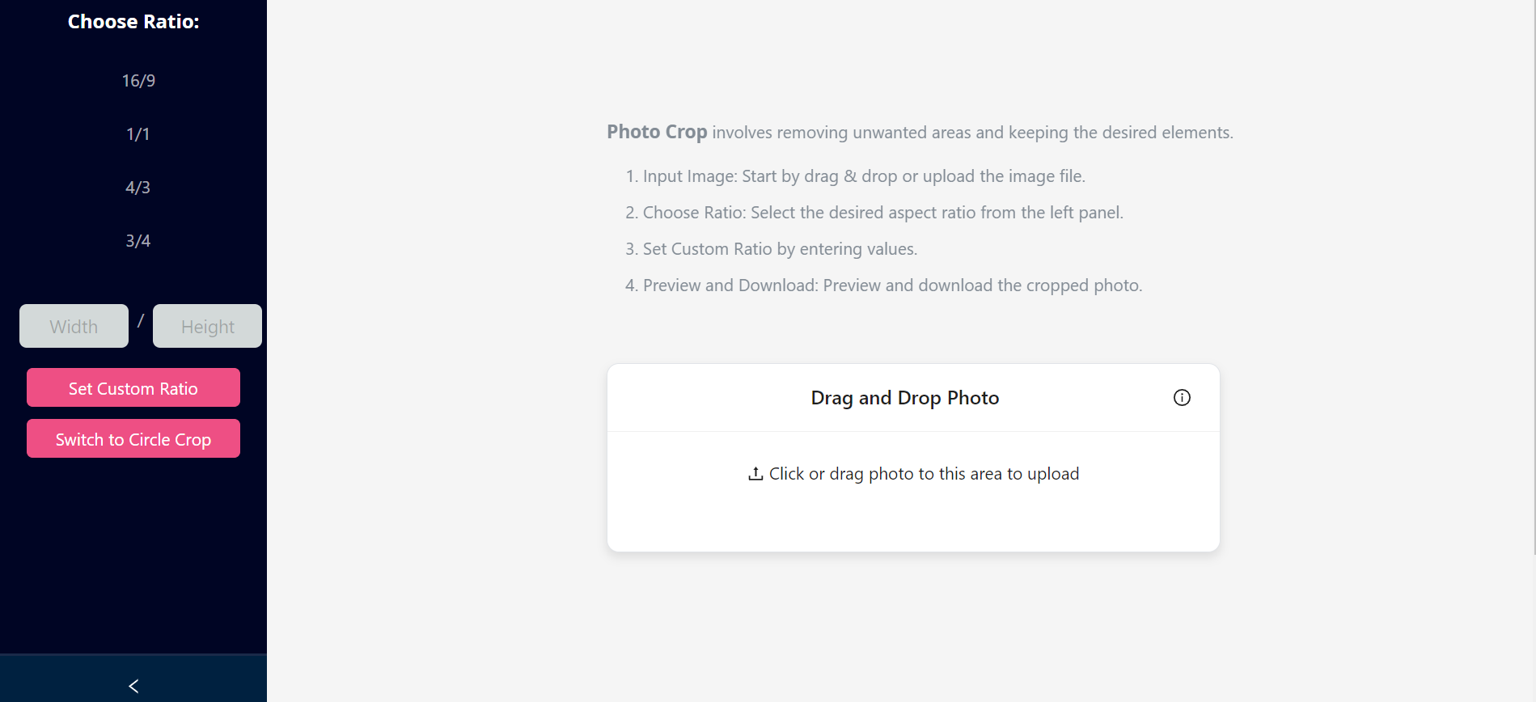
Circular Crop

Slide 4
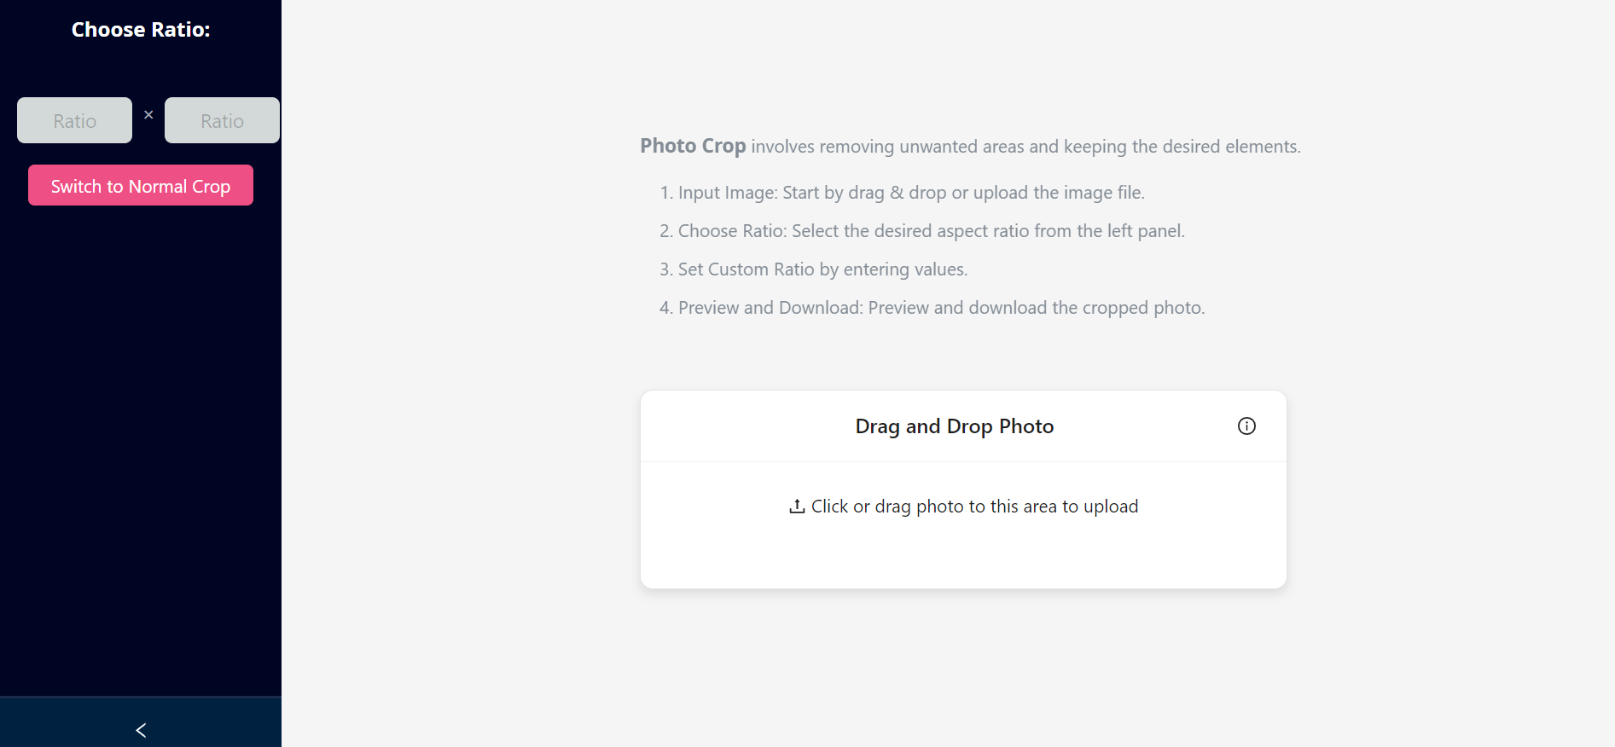
Circular Crop

Slide 5
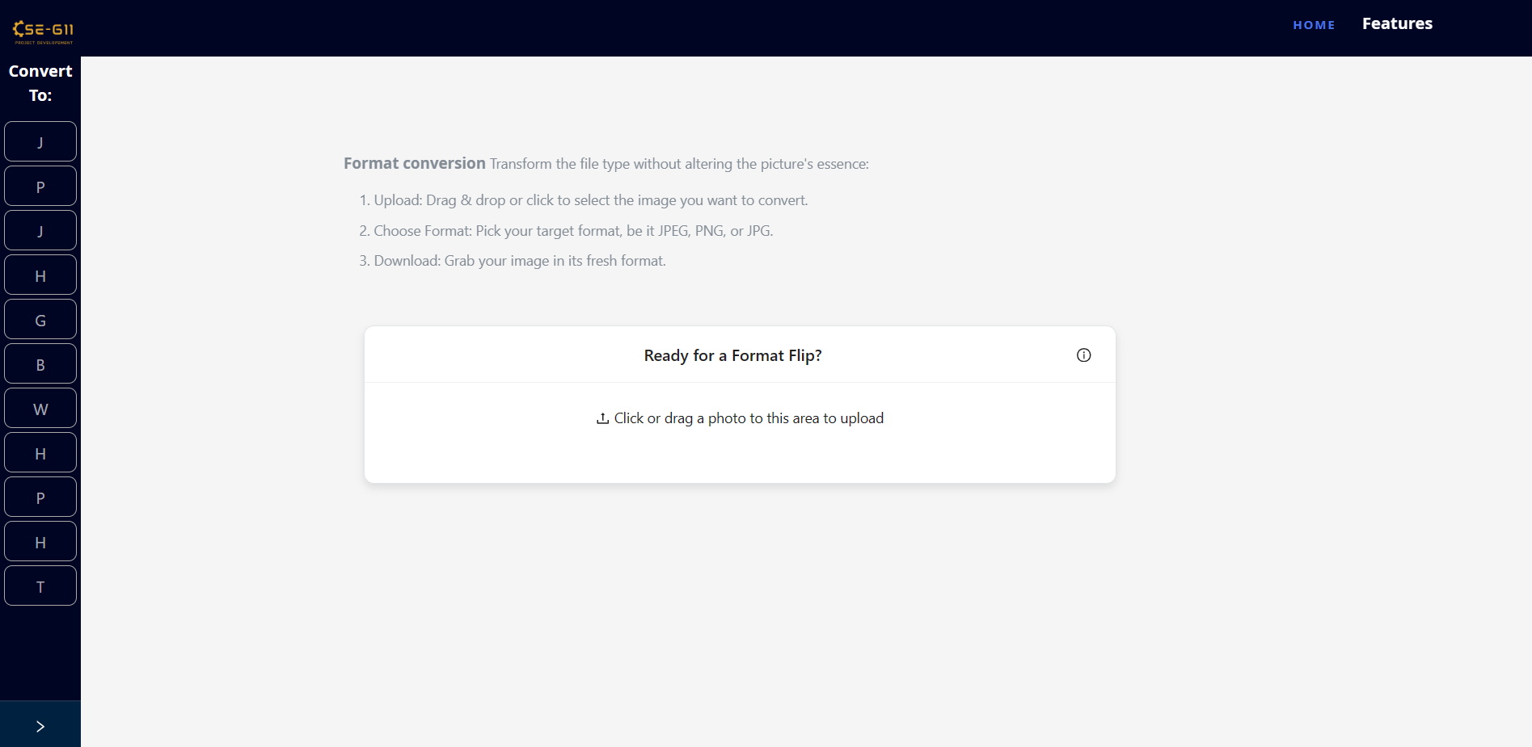
Format Conversion - Before Modernization and Fix

Slide 6
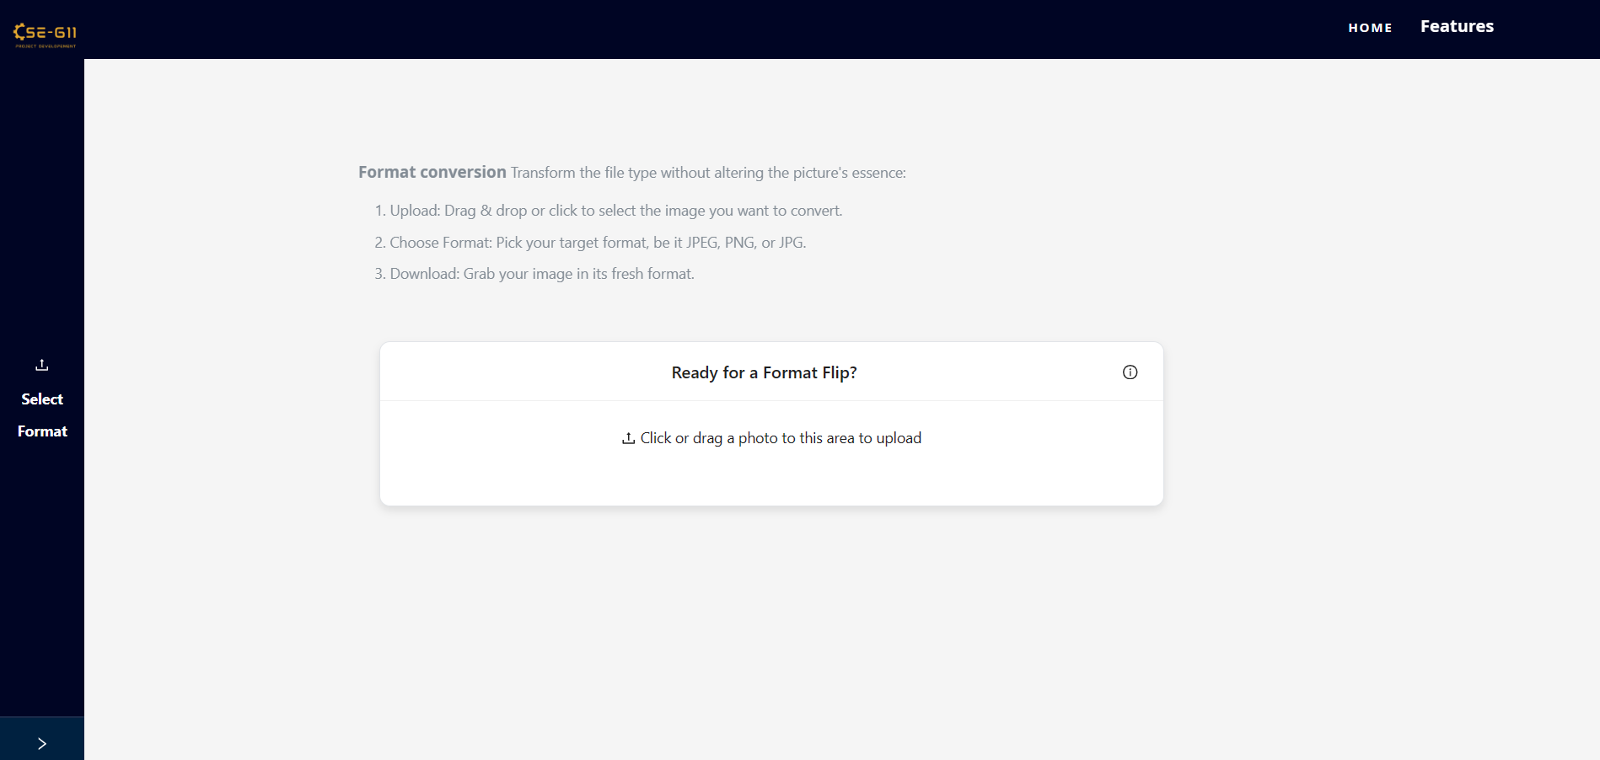
Format Conversion - After Modernization and Fix (As per suggestion)

Slide 7
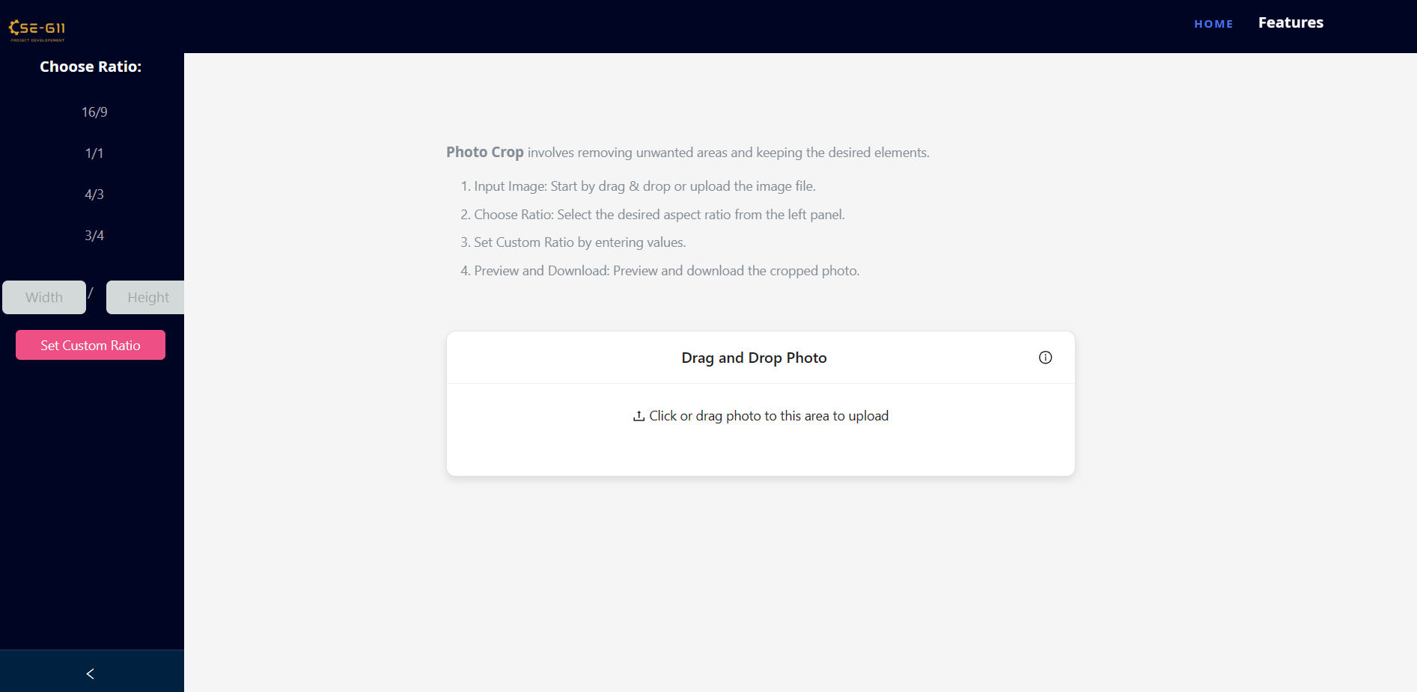
Crop - Before Modernization and Fix

Slide 8
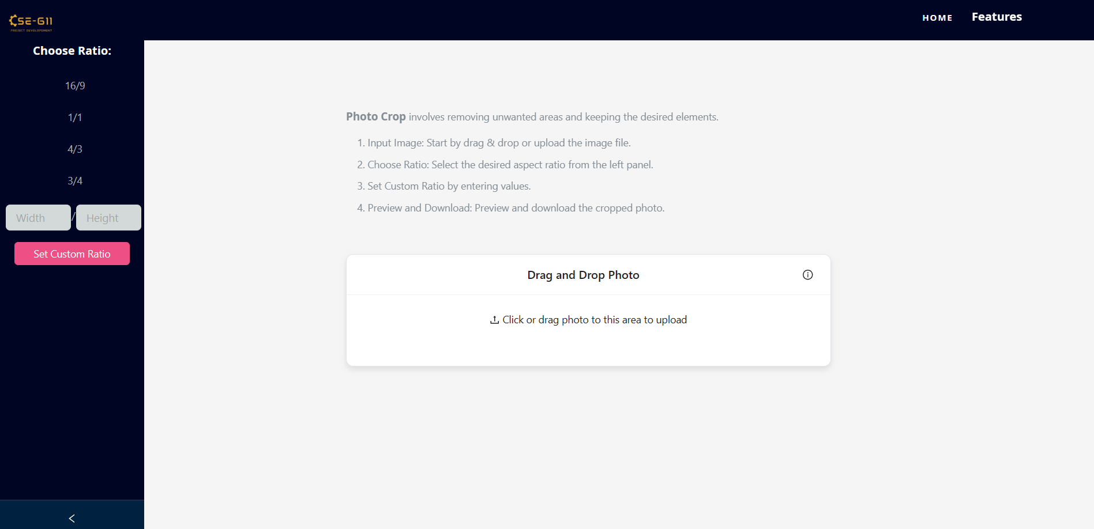
Crop - After Modernization and Fix (Adjusted Width and Height Fields dimensions and position)

Slide 9
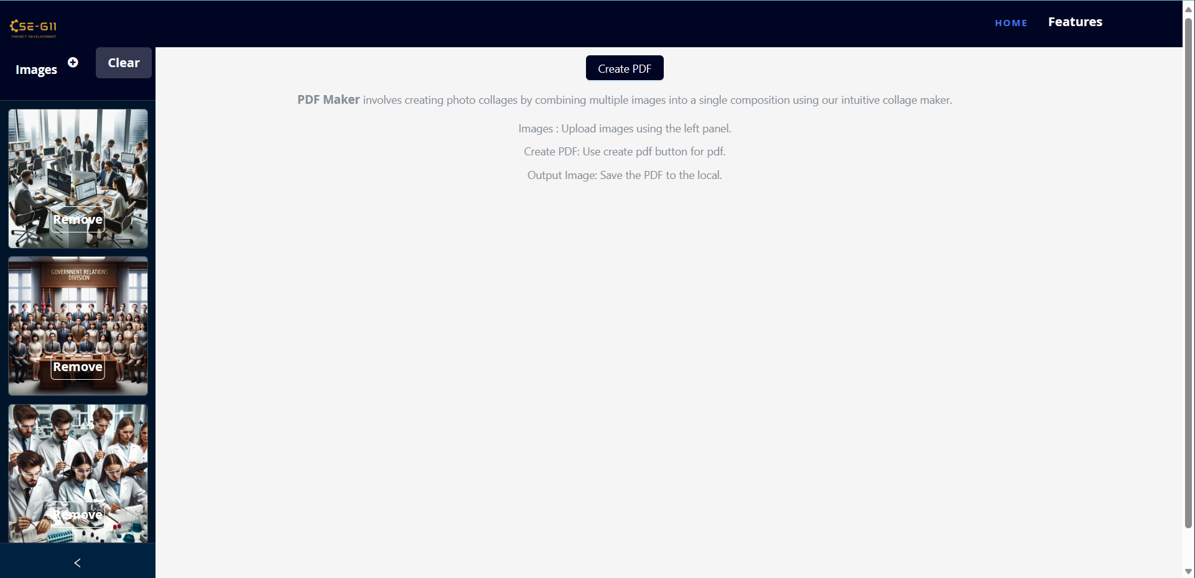
PDF Creator - Before Modernization and Fix

Slide 10
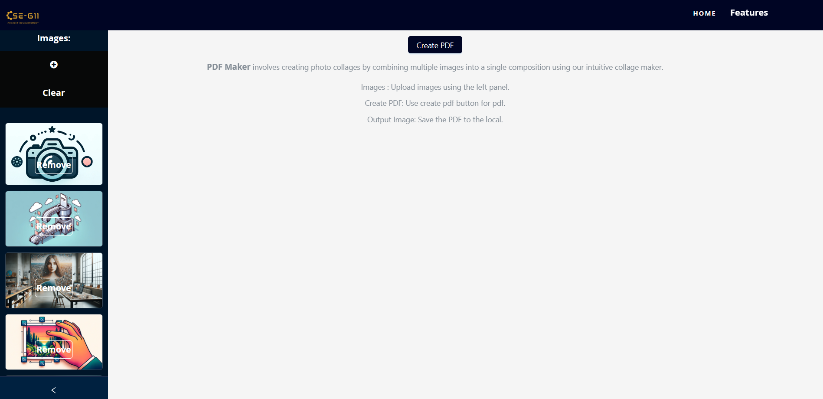
PDF Creator - After Modernization and Fix

Slide 11
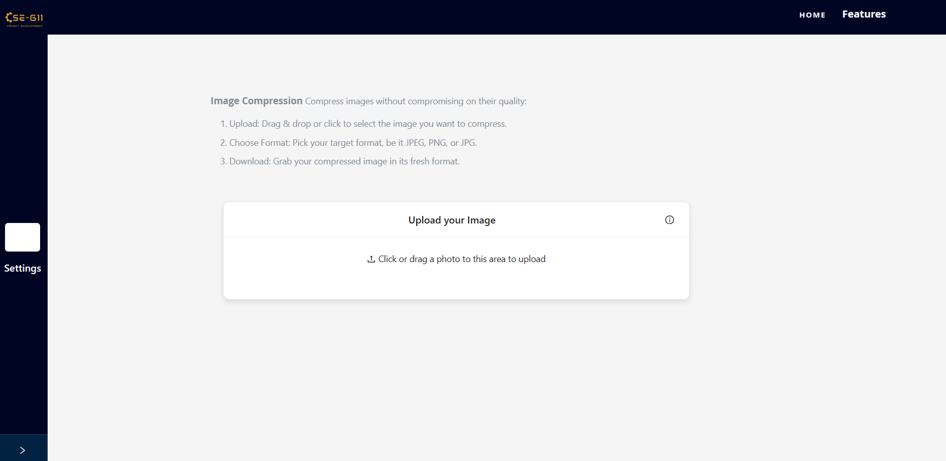
Image Compression - New Feature

Slide 12
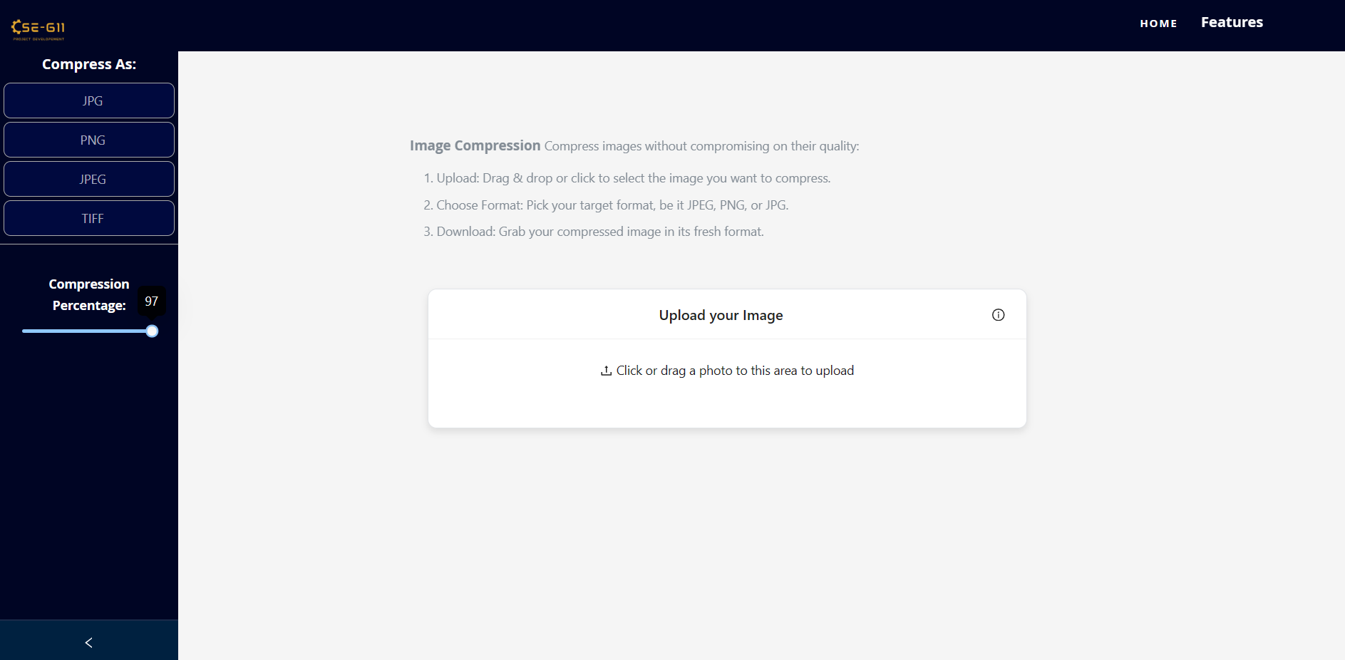
Image Compression - New Feature

Slide 13
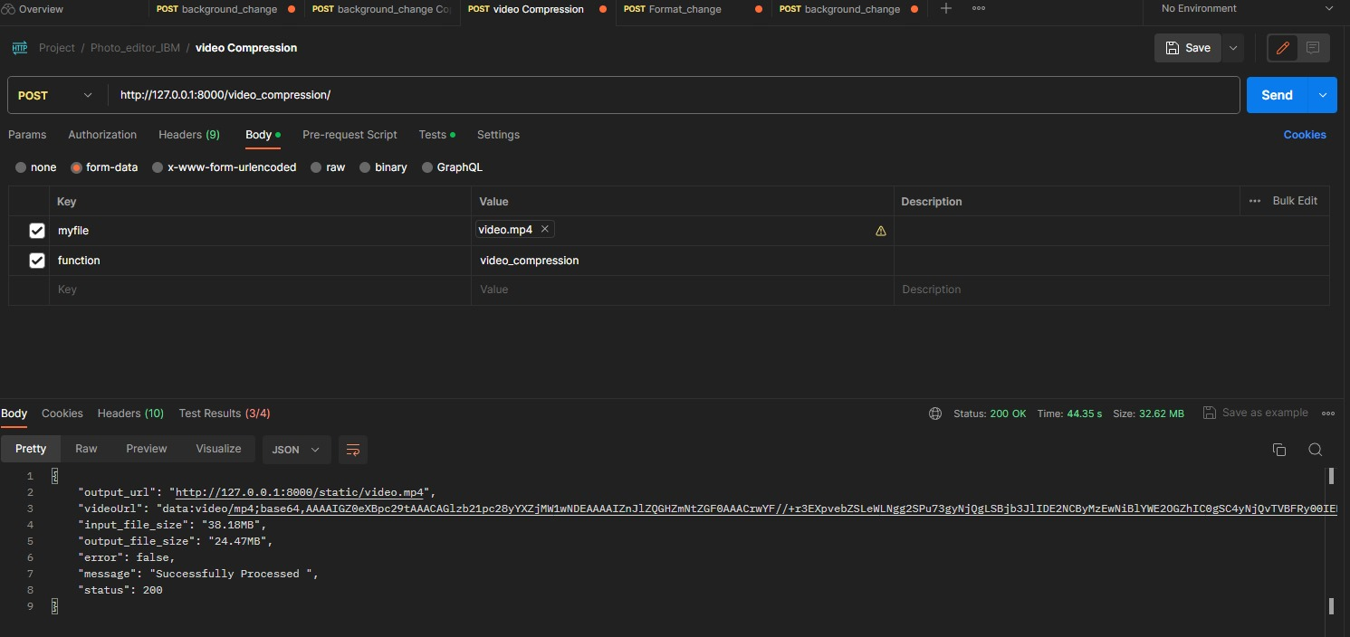
Video Compression

Slide 14
Thank you

